Slide 1
IBM APPLIED DATA SCIENCE CAPSTONE PROJECT
PLACES FOR OPENING A NEW VEGAN RESTAURANT COMPLEX AT MUMBAI, ECONOMIC HUB OF INDIA
By: Ardhendu Mahatha
27th June,2020

Slide 2
BUSINESS PROBLEM
The goal of this project is to find the ideal place to launch the vegan restaurant in Mumbai, India.
We have to find the best location using the Data science and Machine Learning techniques like clustering and also using data visualisation tools like Folium maps etc.
Now we have to spot where Vegetarian people are more in number and Vegan Restaurants are less.
Where would you recommend to open a Vegan Restaurant Complex in Mumbai, India?

Slide 3
DATA SECTION
The data that we need is :
The neighbourhood areas list in Mumbai. This will create the extent of the project in the city. More nos of neighborhood included, more places we can explore.
Next, we will have to get the latitude and longitude of those places and merge it with the neighborhood areas.
Furthermore, we have to explore these places for vegan restaurants and will use this for clustering.
WIKIPEDIA: https://en.wikipedia.org/wiki/Category:Suburbs_in_Mumbai

Slide 4
METHODOLOGY
We will get the data of the neighborhood we need from wikipedia from the link https://en.wikipedia.org/wiki/Category:Suburbs_in_Mumbai. We will do Web scraping using python requests to fetch the data from wikipedia. After that we will use beautiful soup to extract the data and then use the pandas dataframe to store the data. In this way, I have obtained a list of all the names of the neighborhoods of Mumbai.
Next we need to convert the addresses to their geographical coordinates, we will use geocoder for that, we will use python to put the geocoder in a loop and extract all the places coordinates and put them in a separate data frame. Next we will merge the data frames of the names of the neighborhood with their location data. This allows us to do a sanity check whether the data received are correctly plotted on the Map of Mumbai.

Slide 5
METHODOLOGY
Next we will use the folium maps to visualise these neighborhoods within the map of Mumbai. After that we will use the FourSquare API to explore the venues nearby in these neighborhoods. We will use it to get 100 venues that are within a radius of 500. We will make an API call to obtain the FourSquare to explore the neighbourhoods and get the json files to get the details of the venue.
Now we will use this json file To extract the details of the venues from it like venue category, venue latitude, venue longitude etc. We will then examine the data to find how many unique categories of venues exist and then we will perform one-hot encoding to divide the data in categories. Then we will analyze the data by grouping them as per neighbourhoods.
We will filter for Vegan restaurants and sort the data for Vegan Restaurants.Lastly we will use the K-means clustering to cluster the labels. This algorithm identifies the clusters with k no of centroids. We will cluster the neighbourhoods for k=3 no of clusters depending upon their frequency of presence. This result will allow us to identify the presence of Vegan Restaurants. The sample is shown below:

Slide 6
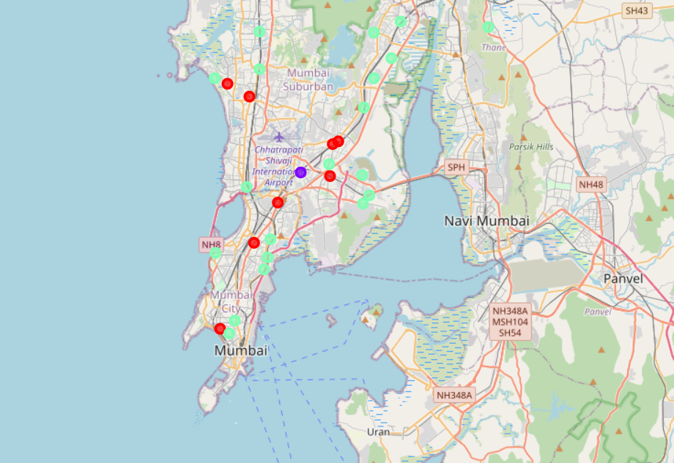
RESULTS
The results of K-means clustering shows how we can categorize the neighbourhood into 3 clusters based on the amount of occurence of Vegan Restaurants.
Cluster0: Moderate no. of Vegan Restaurants.
Cluster1: High concentration of Vegan Restaurants.
Cluster2: Extremely low no of Vegan Restaurants.
The results are visualised in this map cluster0: Red,
cluster1: Blue, cluster2: Green.

Slide 7
DISCUSSION
Vegan restaurants are present in maximum nos at Kurla area. And it is in moderate amount at areas like Andheri, Juhu, Kalyan, Vashi, Chembur etc. and present in a very low amount at areas like Worli, Borivalli, Bhandup etc.
So, businessmen wishing to open Vegan restaurants should not approach the Kurla area,they should focus on the areas of cluster 2 like Worli, Borivalli, Bhandup etc. These areas will have a zero competition and a total monopoly in the market can be achieved.
Cluster 1 places can also be used for the business, since there is a little competition and if the food quality of yours is better, then there is a very nice scope.
And further it is advised to avoid the Kurla area as there is already a high concentration of Vegan Restaurants existing there.

Slide 8
LIMITATIONS
This project is limited to a certain extent because we haven’t included the people’s choice in a certain area, where there are more vegetarians. So we should also include these datas. Furthermore we should also include economic data to find in which area the restaurants can get many customers who can afford it. So, for further studies on it we should also include these datas also.

Slide 9
CONCLUSION
In this project we have gone through identifying the business problem. Then extracting the data, preparing the data and then analyzing the data through several tools like pandas, k-means clustering and then visualising it with folium maps.
Finally we have found that places of cluster2 are best for opening the restaurant and the places of Cluster1 are the second best places for the vegan restaurants. This project is relevant and useful for those who want to open a new Vegan restaurant in Mumbai, India.

Slide 10
REFERENCES
WIKIPEDIA: https://en.wikipedia.org/wiki/Category:Suburbs_in_Mumbai.
MUMBAI CITY: https://mumbaicity.gov.in/document-category/census/ .
FOUR SQUARE: https://developers/foursquare.com .
GEOCODERS: https://geocoder.readthedocs.io/ .

Slide 11
THANK YOU

